Slide 1
Finding optimal k for kNN classifiers
Srikanth Gunturu
Guest Faculty
BITS, WILP

Slide 2
In this segment
Finding optimal k for kNN classifiers
The problem of finding K
Elbow method – Optimal K

Slide 3
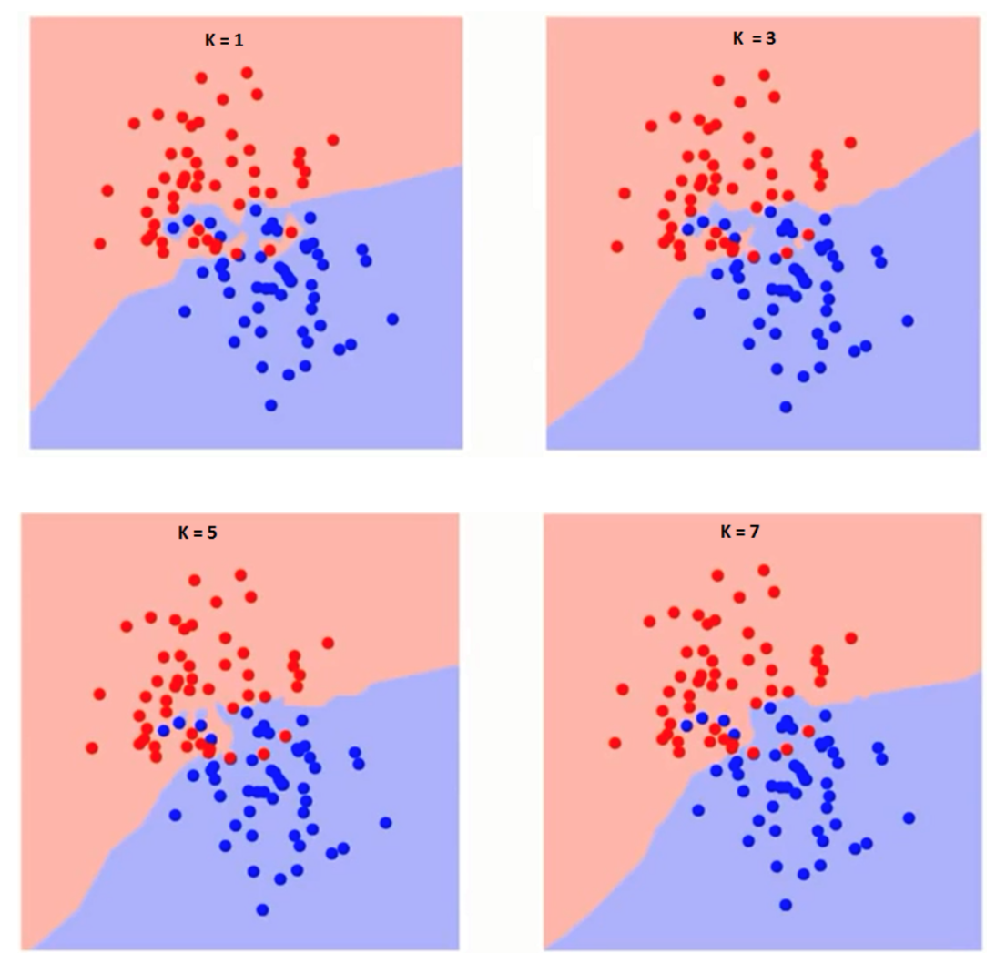
Finding optimal k for kNN classifiers
What is the ideal value of ‘K’?

Slide 4
Finding optimal k for kNN classifiers
Finding K - Elbow method
Compute sum of squares error (SSE) or any other error function for varying values of K (1 to a reasonable X) and plot against K
In the plot, the elbow (see pic) gives the value of K beyond which the error function plot almost flattens
As K approaches the total number of instances in the set, error function drops down to ‘0’, but beyond optimal K, the model becomes too generic
Error function (SSE)
K value

Slide 5
Thank You!
In our next session:
Python implementation of kNN classifier

